Slide 1
Edinburgh Business School MBA
AUC Academic Partner
Strategic Planning
Revision
Instructor: Moataz Darwish, MBA

Slide 2
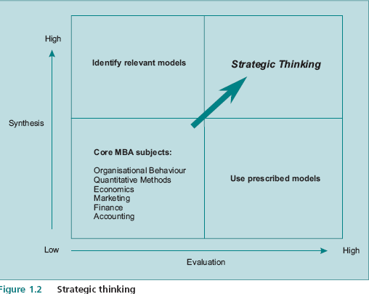
What Is Strategic Planning?
The Strategic Planning and Strategic Thinking
  two skills which are fundamental to strategic thinking:
    synthesis and
    evaluation.
Identify the relevant models to
apply to a particular issue.
Weigh up the pros and cons of
potential courses of action and
arrive at a reasoned conclusion

Slide 3
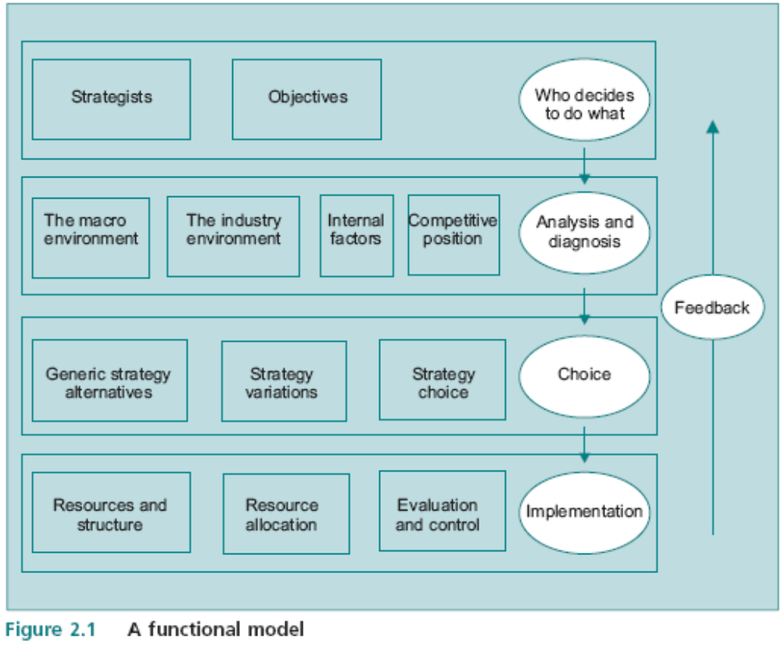
The SP Model
4 Rows
5 Eggs
12 Boxes
SO
MIIC
GVC
SAC
W
A
C
I
F

Slide 4
Augmented Model - summary
Who Decides To Do What
Analysis And Diagnoses
Analysis And Diagnoses
Choice
Implementation
OBJECTIVES
Business Definition
Mission
Shareholder wealth
Gap analysis
Means and ends
Ethics
Profit maximisation
Growth vector (Ansoff)
Stakeholder map
Credible, quantifiable,
disaggregated, economic,
Financial
Principal agent
CSR
STRATEGISTS
Prospector, analyzer, defender, reactor
Risk aversion
Principal agent
Team composition
Group dynamics
Corporate Governance
Culture: power, role, task,
personal
THE GENERAL ENVIRONMENT
Macroeconomic analysis:
unemployment, inflation,
interest rate, exchange rate
Forecasting
Competitive advantage of
Nations (Diamond)
Environmental scanning
PESTEL
Scenarios
THE INDUSTRY AND INTERNATIONAL
ENVIRONMENT
Demand and supply, price
determination, elasticity
Barriers to entry
Forms of competition: perfect, imperfect, oligopoly, monopoly
Segmentation
Differentiation
Quality
Strategic groups
INTERNAL FACTORS
Value chain
Shareholder value analysis
Competence (resources/routines matrix)
Architecture
Experience curve
Economies of scale
Economies of scope
Innovation
Synergy
Joint production
Opportunity cost
Marginal analysis
Ratios
Gearing
Cash flow
Benchmarking
Human resource management
Culture: power, role, task,
personal
COMPETITIVE POSITION
Product life cycle
Market share
Portfolio analysis (BCG)
Perceived differentiation
Strategic groups
First mover
Five forces
Competitive reaction
Elements of competitive adv
ETOPS
Strategic advantage profile (SAP)
GENERIC STRATEGY ALTERNATIVES
SWOT
Corporate strategy:
Stability, expansion,
Retrenchment, Combination
Business C strategy: Cost leadership, Differentiation, Focus
Segmentation
Strategy variations
Diversification: related and
unrelated (Fam Matrix)
Vertical integration
Mergers and acquisitions
Joint ventures and alliances
Pricing: leadership, limit,
predatory
Strategy choice
Risk analysis
Managerial perceptions
Net present value
Familiarity Matrix
Scenarios
Break even
Payback
Sensitivity
Game theory
RESOURCES AND STRUCTURE
Divisional, functional, matrix
Managerial style
Critical success factors
Incentives
Resource allocation
Opportunity cost
Marginal analysis
Optimisation
Budgets
Critical success factors
Evaluation and control
Performance measures
Ratios
Degree of Planning and type of Control
Monitoring systems
FEEDBACK
Communication
Management style
Adaptability
Learning organisation

Slide 5
Module 2 & 3
Strategist & Objectives

Slide 6
Who decides to do what
Business Definition:
  Name (Brand) / Products / Segments / Geography / Position
Strategist: Strategist / Leader / Decision makers/ Board (relate to Generic Strategy & Implementation)
  Prospector / Analyzer / Defender / Reactor.
  Principle agent problem/Control/Power/Conflict/Culture (relate to Mod 6).
  Stakeholders (Interests/Influence), corporate governance, CSR.
  Management skills.
Organization: (relate to Internal & Implementation-structure)
  Small (Entrepreneurial) single product company - owner-manager,
  Integrated company,
  Large diversified company (SBUs).
Objectives (What are they trying to achieve): (relate to Strategy/Targets)
  Means (how) vs. ends (what)
  Growth (new products, market share); Max Profitability; stability (efficiency/cost cutting), reputation, survival, or no clear objective.
  Principle agent problem.
  Conclusion: Clear Obj.? Confusing / Weak?...

Slide 7
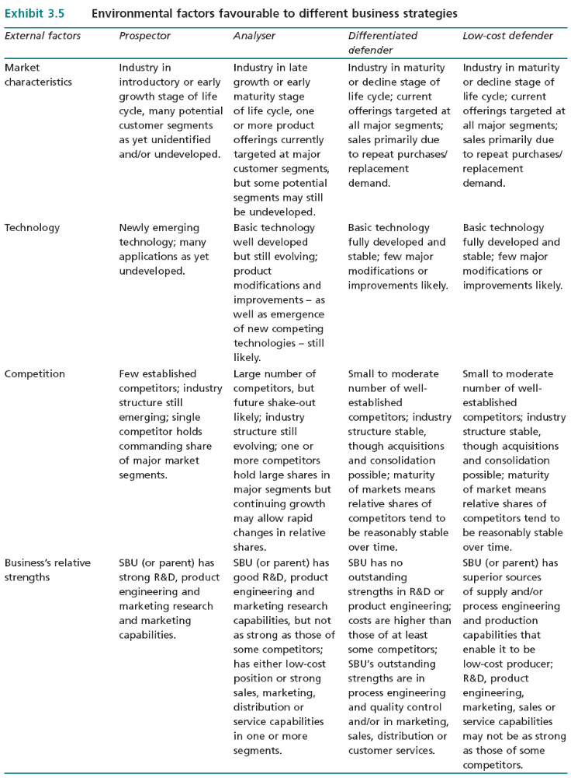
PLC
PEST
Market
Structure
Internal
Strength

Slide 8
Module 4
Macro Analyses

Slide 9
Revenue and Costs: the Basic Model
Economy-wide changes can have significant effects on revenues and costs.
The model is constructed by identifying the variables which determine revenue and costs and determining the factors which affect these variables.
Revenue = Total Market x Market Share x Price
Outlay = Number of Workers x Wage Rate
+ Units of Capital x Price
+ Units of Material x Price

Slide 10
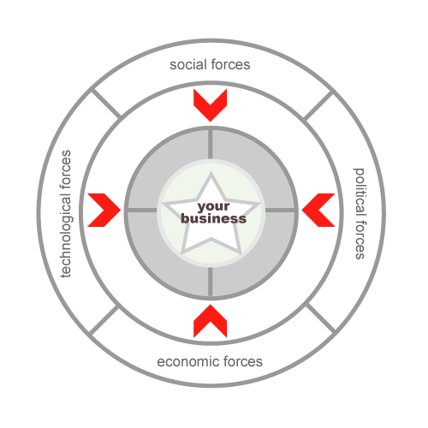
Macro-environment
Forecast
Short-term
PEST
What is likely to happen
Scenarios
Long-term
Present
Env Scanning
Likely Impact on
Future+wider range variables
Sales and revenues (purchasing Power)
Competitive Reaction
I/P costs (wage rates & investment costs)

Slide 11
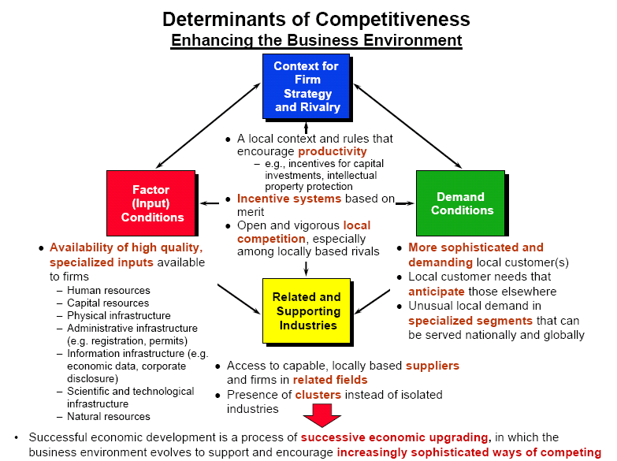
The International Economy
The importance of the national framework is summed up in the Porter National Diamond Framework :
    Factor conditions
    Related and supporting industries
    Demand conditions
    Strategy, Structure and Rivalry
    When assessing a company’s competitive advantage:
    If country specific - exploit foreign markets by exporting.
    If company specific - can invest in the country concerned, insulating it from exchange risks..

Slide 12
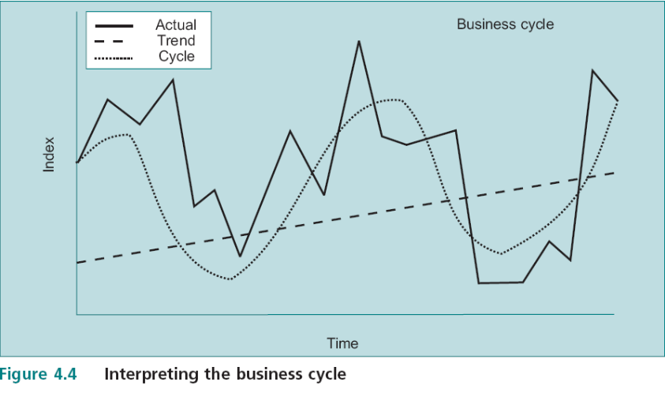
Forecasting: What Will Happen Next?
  One approach is to think in terms of the business cycle – series decomposition
    Cyclical patter of boom & depression
      3 components: general trend over time, the underlying smooth cycle, and random fluctuations.
What is the trend? Or discontinuity?
“long term growth rate in potential output”
What is the underlying cyclical pattern?
What random influences are likely to be disturbing the trend?

Slide 13
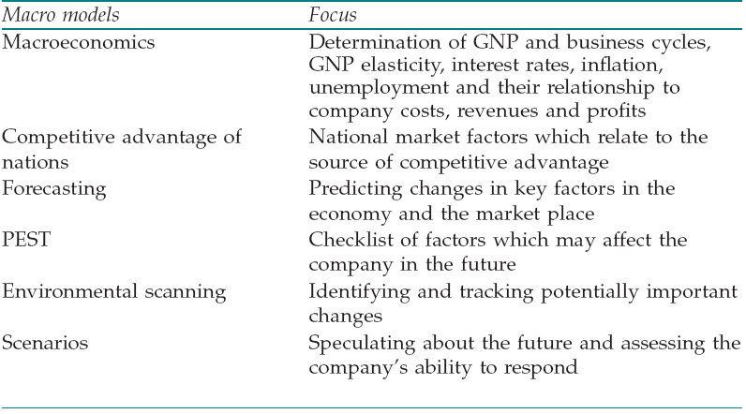
An Overview of Macro Models
The macro models are used to identify trends and changes in the variables which affect the market in which the company operates;
EBS MBA / AUC

Slide 14
Module 5
The Company and the Market

Slide 15
The Market
Corporate Level
  Are we in the right markets?
  What resources should be allocated to various markets?
Business Unit Level
  What price should we be charging for our product?’
  How much should we be spending on marketing?’
Functional Level

Slide 16
The Industry Environment
Product Life Cycle (PLC)
  Demand/Time (Intro, Growth, Maturity, Decline)
BCG Portfolio Model
  Relative Market Share - compared to that of its leading competitors. (link w Economies of scale / experience effect)
  Market Growth Rate (link w stage of the PLC
Porter Five Forces
  Threat of new entrants, Threat of substitutes, Suppliers’ bargaining power, Buyers’ bargaining power, Industry competitors’ rivalry
  Comparison bet. 2 products/ 2 companies/ 2 countries/ 2 periods
  Link w Supply/Demand and PLC
Price / Differentiation Matrix
Ansoff’s Growth Vector (relate to Familiarity matrix – Fig 7.4)
  Direction in which the company intended to develop its portfolio.

Slide 17
The Industry Environment
Supply and Demand:
  Supply & cost structure (Sellers capacity utilization, cost of increasing capacity, availability and wage costs of additional employees, availability of raw materials, potential for foreign competitors to enter the market…)
  Demand (what Buyers are willing to pay (price) for different quantities
  Prices (Supply-Demand interaction)
Market Structures:
  Perfect Competition (homogeneous, no barriers to entry, no economies of scale, availability of information, large number of sellers and buyers)
  Monopoly (one producer, barriers to entry, product differentiation)
  Contestable Markets (entry costs are not sunk, and exit can be achieved costlessly).
  Oligopoly (few competitors )
  Barriers to Entry (Structural->Size of the market, Sunk costs, Control by legislation, Economies of scale, Experience effect; Strategic->pricing)
Strategic Groups:
  Similar to one another and different from firms outside the group on one or more key dimensions of their characteristics and strategy.

Slide 18
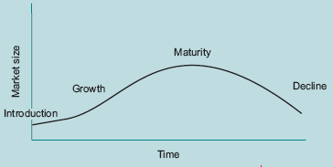
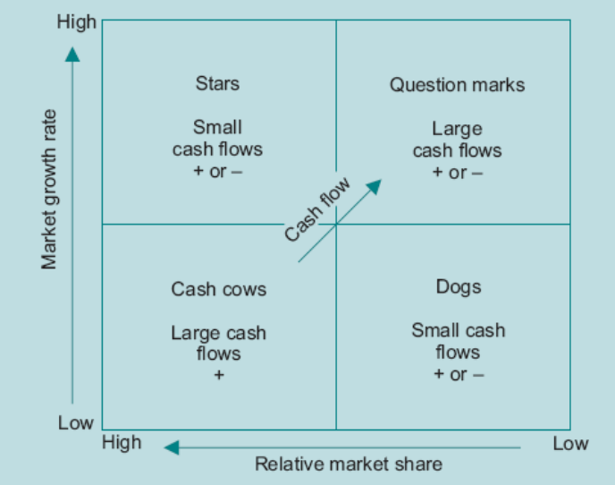
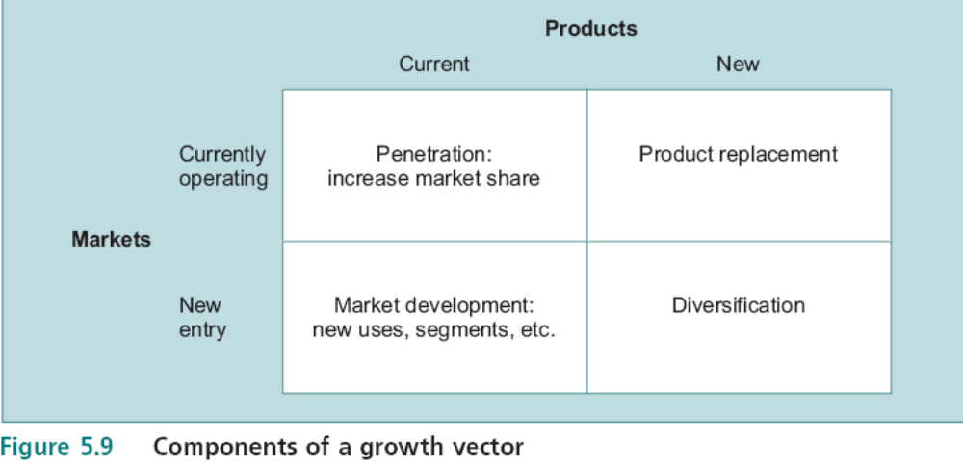
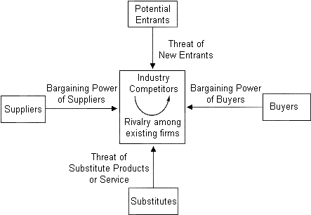
Linkages
Shakeout
time
Higher risk
Capacity
Profit

Slide 19
Segmentation
Market segment is:
  a group of consumers within a broader market who possess a common set of characteristics,
  and consumers in a segment respond to market mix variables in broadly the same way.
Some characteristics for market segmentation are:
  income, social class, geographical location, age, sex, family size, educational background, etc.
Four main characteristics which a segment needs to have:
  Identifiable: sufficient common features; Demand related: at least one characteristic which translates into demand terms, ex. willingness to pay more for a high quality product; Adequate size: to ensure attractive return on the investment; Attainable: be reachable by available marketing and advertising approaches.
  Segmentation is a potentially powerful tool for transforming a loss-making product into a profitable product without changing anything but the price charged to different groups of consumers.
EBS MBA / AUC

Slide 20
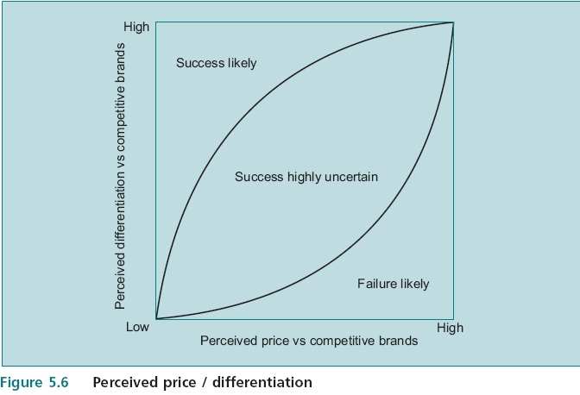
Price / Differentiation
  Extends the concept of segmentation to the determination of which bundle of characteristics should be incorporated in the version of the product targeted at each group.
  The two most important determinants of a product’s success are likely to be:
    the price of the product compared to similar products,
    and the degree to which consumers perceive the product as a different offering (perceived differentiation) – ex Aspirin
A base of differentiation must fill some customer need (tangible or intangible): Image, hunger, comfort, cleanliness, beauty, status, style, taste, safety, quality, service, accuracy, furthering a cause, reliability in use, belonging. Some bases of differentiation also lend themselves to low cost
EBS MBA / AUC

Slide 21
Product Quality
Dimensions of Quality - multidimensional nature of quality
  Garvin
    Performance, features, reliability, conformance, durability, serviceability, aesthetics, overall perceived quality.
Quality and Strategy
  Relationship between product characteristics and market performance;
  Quality and advertising;
  Quality is positively related to market share,
  Quality and profitability (as measured by ROI) are correlated.
  While quality appears to be a potentially powerful strategy tool, it is difficult to be precise about exactly how it might contribute to company success.
  Total quality management (TQM) / standards
EBS MBA / AUC

Slide 22
The Role of Government
Although the market is an efficient resource allocator, there are some areas in which it does not appear to function very well, “Market Failure” issues.
An understanding of this aspect of government is an important input into: PEST analysis / environmental scanning / scenarios
Government and Rule Making - Employment law, Monopoly, Health and safety at work, Separation of management and ownership (Governance), ex. Enron
Government and Regulating – ex attempt to reduce pollution (outcome of ‘externalities’) -> internalize the externality through regulating output, setting emission standards, or imposing taxes.
Government and Allocating - public goods
EBS MBA / AUC

Slide 23
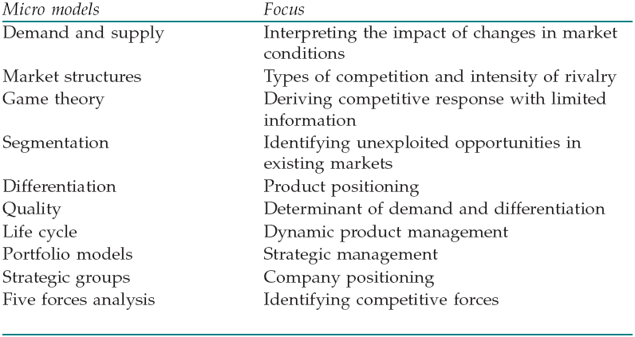
An Overview of Micro Models
The micro models are specific to the industry and identify the company’s position within its immediate competitive environment.
EBS MBA / AUC

Slide 24
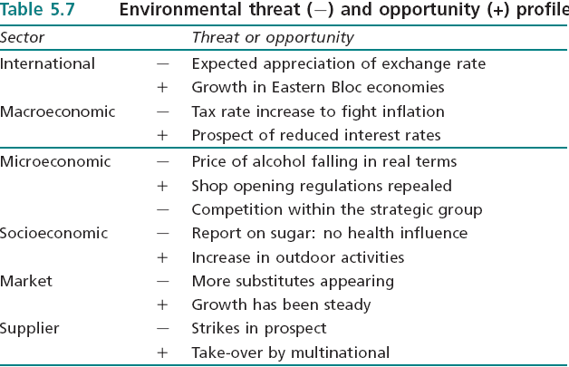
Environmental Threat and Opportunity Profile: Part 2
The idea of the ETOP was introduced at 4.9 as a method of systemising diverse information in order to formulate an overall strategic view. While the ETOP has not provided ready made answers to strategy, it has enabled us to bring together many ideas in a framework which makes it possible to identify key issues in context.
EBS MBA / AUC

Slide 25
Module 6
Internal Analyses

Slide 26
Internal Analysis
Economies of scale
Economies of scope
Experience curve
Fixed Costs, Variable Costs and Sunk Costs
Production Costs
Joint Production (sheep & wool-allocation)
Break-Even Analysis
Payback Period
Accounting Ratios
Vertical Integration
The Value Chain
Diversification
Synergy
Competence
Strategic Architecture
Opportunity Cost
Marginal Analysis: relevant cost as o/p varies
Diminishing Marginal Product
Profit Maximisation
Sensitivity Analysis
Benchmarking
Research and Innovation
Development
Resource Management
Human Resource Management
EBS MBA / AUC

Slide 27
Reduction in unit cost due to
The scope of the company
Economies of Scale
Economies of Scope
Experience Curve
(Economies of Learning)
  High scale of ops
  “no. of units produced”
  Entry Barrier
  close to synergy
  “no. of products”
  Reputation, shared I/P,
  R&D spillover…
  Output to-date
EBS MBA / AUC
Notes:
Other cost efficiencies: supply cost and product design.

Slide 28
Accounting Ratios
Ratios produce performance measures which relate to the efficiency with which resources are allocated, appropriate measures must be used for:
  Revenues / Costs / Assets
  Assets appear in the bottom line of most of the measures,
The following ratios are typically encountered in company accounts:
  Profit Margin = Profit / Sales
  ROI (Return on Investment) = ROE (Return on Equity)* = Profit / Owners Equity
  ROTA (Return on Total Assets) = Profit / Total Assets
  RONA Return on Net Assets = Profit / Net Assets
  Gearing ratio = Total Debt/Total Assets; Total Debt/Total Equity*100
  ROCE (Return on Capital Employed) = Profit/ Capital Employed (Total Assets -current Liabilities)
*Assumed to be the same for simplicity

Slide 29
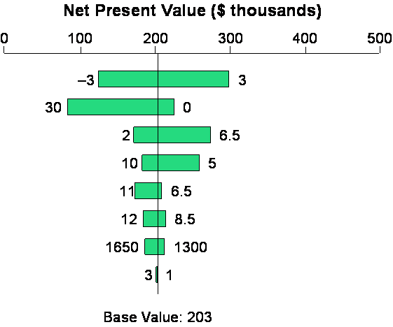
Sensitivities

Slide 30
Research & Development
Innovation as a process
Invention
what incentives exist? Intellectual property rights and principal agent issues.
Many possibilities for delay.
Need for monitoring the process.
organization needs to pay a great deal of attention to incentives and be adaptable to changing priorities at different stages.
screening mechanism
Prototype
criteria to determine what has the potential
Patenting Delay, is it needed?
Patent
invention cannot be defined well enough for patenting purposes, imitation threat
Prioritizing prototypes
Development
how much should be spent?
Conflict between engineers and marketers
Launch
proper positioning in terms of differentiation and price.
Success of launch?, further resources?
abandonment?
Market exploitation
marketing approach

Slide 31
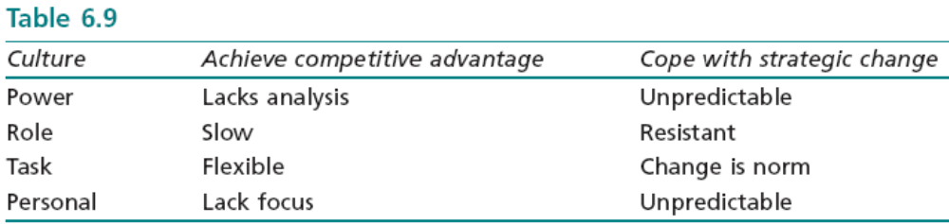
Human Resource Management
Link to (who decides to do what?)
Things to consider:
Hiring and firing costs
Attrition rate
Overtime
*what might appear to be a cultural problem may in fact be due to the more general principal agent problem, ex. the incentive system.
EBS MBA / AUC

Slide 32





Vertical Integration
Every product has a supply chain which starts from the extraction of raw materials and involves manufacture, distribution and sales to the final customer;
Vertical integration, Forward integration, Backward integration (related to Business definision.
Upstream
Midstream
Downstream
Raw Material
Distribution
Retail and Customers
Manufacture
EBS MBA / AUC

Slide 33
Vertical Integration
what is the rationale for vertical integration?
  Company should make or buy from the Market?
  Benefits and Costs of using the market rather than producing internally:
  Make rather than buy generates some formidable principal/agent problems.
  Internal pricing system + difficulty in identifying where value is being created or destroyed.
    Some allow managers the option of buying from outside suppliers if their price is lower;
Benefits of Buy:
Market firms can achieve economies of scale
Market firms are subject to the discipline of the market (efficiency and control);
Costs of Buy:
Coordination of production flows may be compromised
Private information may be leaked to competitors
Transaction costs may be incurred.

Slide 34
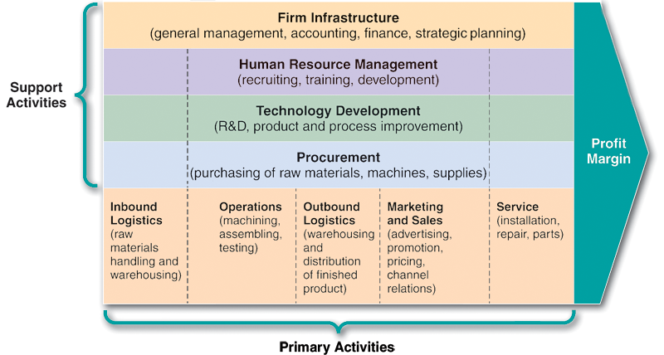
The Value Chain
A company can be visualised as a chain of value producing activities
The overall value is represented by profitability
Analysing the components & linkages

Slide 35
Diversification
Firms need to confront the issue of the optimal degree of diversification.
Four main incentives to diversify:
  to minimise risk - Management risk not Shareholder risk
  to capture economies of scope – might lead to value destruction, spreading scarce top management skills across apparently unrelated business areas through the application of their dominant management logic (dangerous)
  to add value through the parenting function
  to benefit from synergy
EBS MBA / AUC

Slide 36
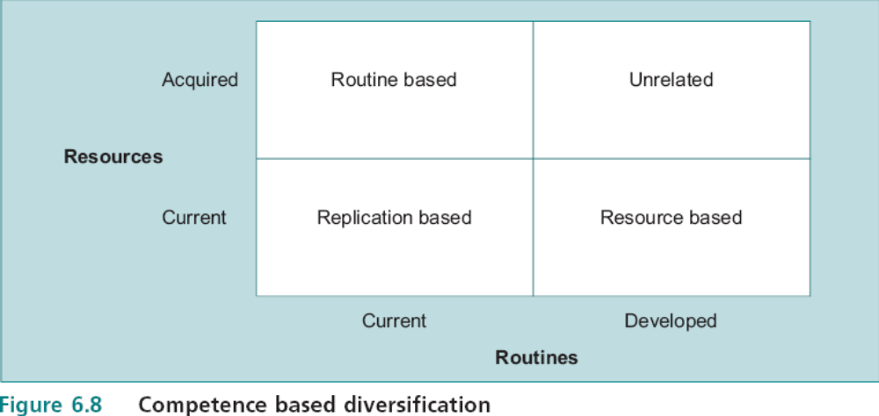
Competence
Routine-based Diversification:
-Ex. ScottishPower: from electricity utility
company into water, gas and telecommunications.
-Same Routines (or Competences ) were relevant for the management of different types of
Utility - existing systems and distinctive capabilities.
Resource-based Diversification:
-Ex. EBS distance learning MBA: from conventional learning into long-distance.
-Same Resources were the capabilities of a strong team of core business academics.
-New routines included self-contained teaching packages, self assessment and the use of sophisticated examinations to measure performance.
Routines: distinctive capabilities
Resources: core inputs
EBS MBA / AUC

Slide 37
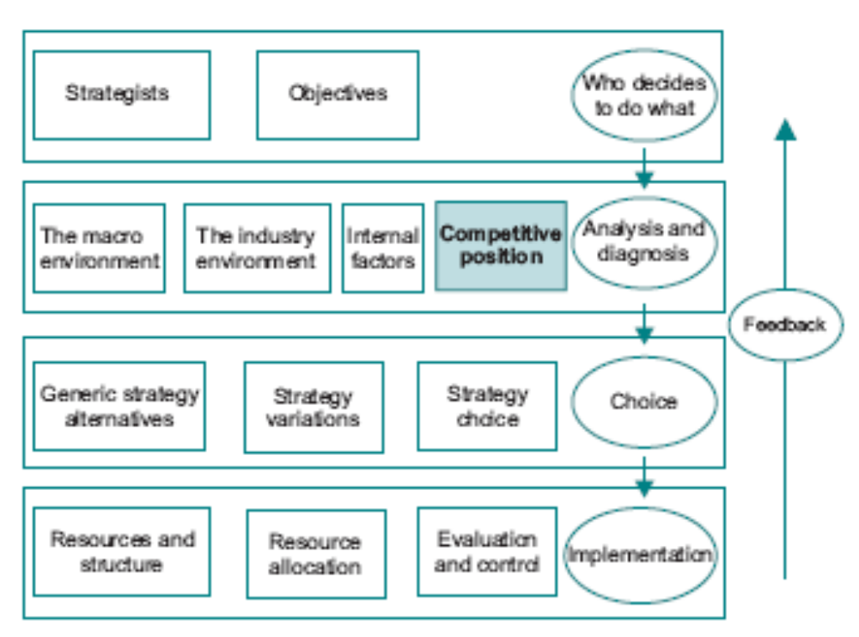
The Definition of Competitive Advantage
EBS MBA / AUC

Slide 38
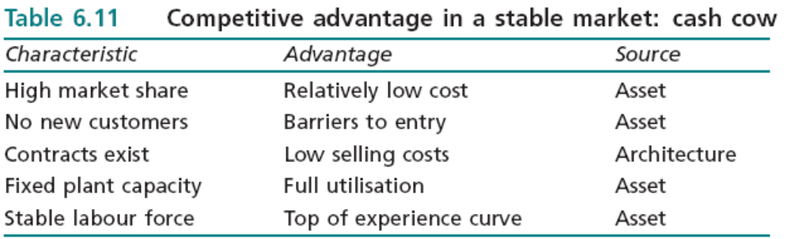
The Definition of Competitive Advantage
EBS MBA / AUC

Slide 39
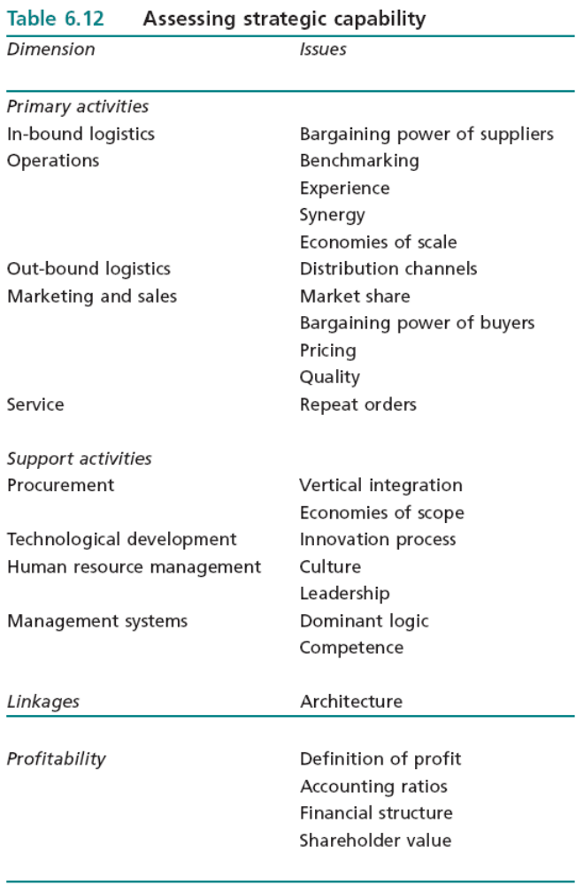
The Definition of Competitive Advantage

Slide 40
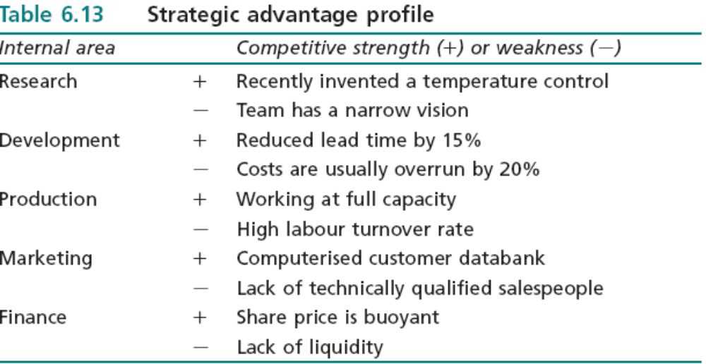
Strategic Advantage Profile
EBS MBA / AUC

Slide 41
Strategic Planning
Module 7
Making Choices among Strategies

Slide 42
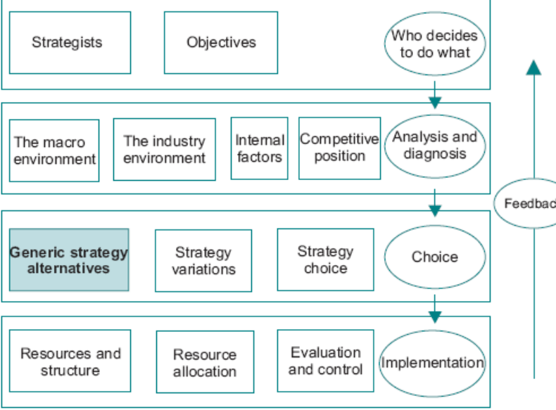
Contents
A Structure for Rational Choice
Strengths, Weaknesses, Opportunities and Threats
Generic Strategies
  Corporate Level Generic Options
  Business Level Generic Options
  Decision Maker Generic Strategies
  Generic Strategies and Company Performance
Identifying Strategic Variations
Strategy Choice
EBS MBA / AUC

Slide 43
Strengths, Weaknesses, Opportunities and Threats
ETOP & SAP can be combined together to identify where matches occur between the two → SWOT
SWOT analysis is an essential first step in:
  assessing what the company needs to do to protect its current market position,
  and in identifying potential strategic thrusts which can capitalise on company strengths and market opportunities.
  It is not always a simple matter to categorise factors and recognise opportunities and threats for what they are;
  That is why it is so important to understand the core disciplines and be able to think through the implications of market information.
EBS MBA / AUC

Slide 44
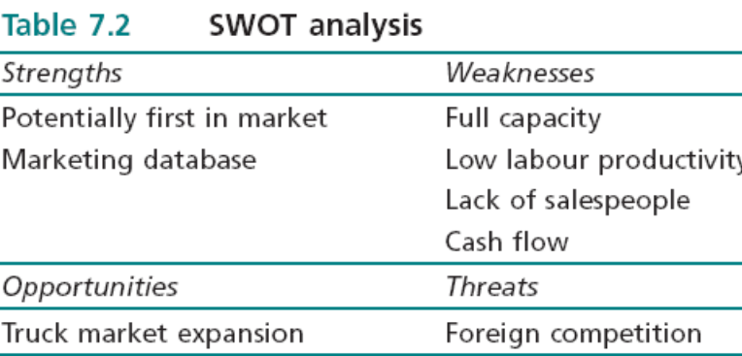
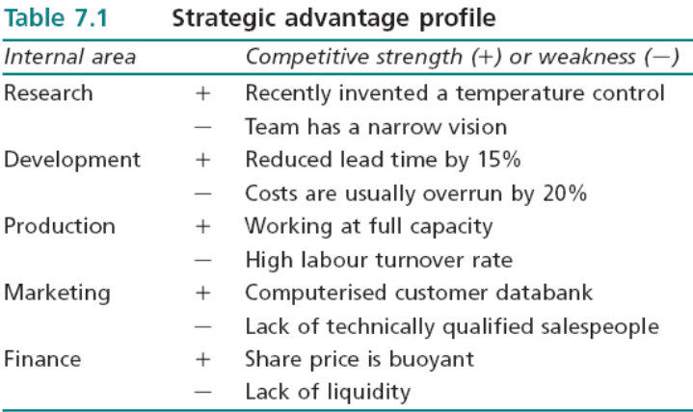
Strengths, Weaknesses, Opportunities and Threats
ETOP
Short term
Corporate
SBU
Ex. Cost/mkt share/efficiency
SWOT
SAP
Long Term
Corporate
SBU
Ex. Move along Ansoff matrix
EBS MBA / AUC

Slide 45
Generic Strategies
Corporate Level Generic Options
  Scope of the company and the directions it will pursue, for example the development of new products or the acquisition of companies to increase the product portfolio.
  Mangers have to have: comprehensive analyses, explicit about which generic alternative they are pursuing and why.
  It is important to be clear about what the strategy options are NOT (ex. Expansion can not be defined as increase profitability) .
  The generic strategy is one of the means by which the end of profitability may be achieved.
2. Business Level Generic Options
  focus on effective exploitation of individual product markets, as opposed to the overall resource allocation problem facing corporate level strategists.
    Individual product OR strategy approach to group of products
Generic strategies are the basis on which the company attempts to build its competitive advantage; without a clear idea of the generic strategy which it is pursuing, a company is likely to end up with no identifiable strategy with the result that it will lack direction and strategic intent.

Slide 46
Generic Strategies
Decision Maker Generic Strategies
Prospector
Analyzer
Defender
Reactor
Corporate Generic Strategies
Stability
Expansion
Retrenchment
Combinations
Business Level Generic Strategies
Cost Leadership
Differentiation
Focus
Stuck in the Middle
EBS MBA / AUC

Slide 47
Generic Strategies
Corporate Generic Strategies
Stability
Expansion
Retrenchment
Combinations
Stay the same NOT steady
Expand
Get smaller
Change mix of activities
Relatively small performance gap
Markets are mature, long lifecycles
Internal weaknesses - aim to increase efficiency
Unstable financial history
Poor economic prospects, business cycle downturn
Competitive threat
Perceived costs of change – change averse
Managers averse to risk
Not trivial option – needs substantial internal changes
Diversifying risk
Searching for competencies or opportunities fit with it
Economies of scale
Experience effects
Building advance capacity (in recession)
Managerial motivation (remuneration/reward)
Re-structuring/ Down-sizing/ De-layering
End of Product life cycles
Dogs (divest)
Overextended markets (losing money on some markets)
Drive for efficiency
Either:
1-Diff strategies in diff SBUs (redeployment) OR
2-Sequentially
Opportunity cost
Product portfolio
Different generic strategies are appropriate in different circumstances.
What criteria to decide on? Depends on Co Objectives and adding most value to Shareholder wealth (3.12.6)
the distinction between means and ends must be maintained.
EBS MBA / AUC

Slide 48
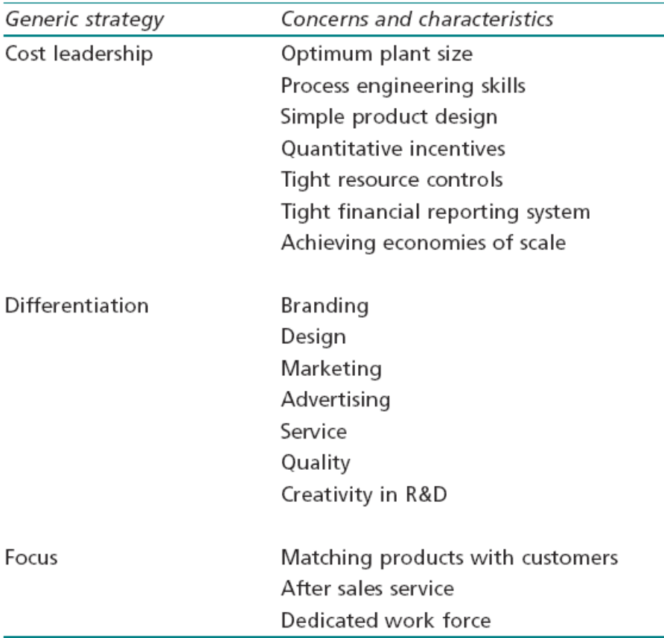
Generic Strategies
Cost Leadership – 2 preoccupations:
  Market share (high initial investment)
  Efficient resource allocation, forefront of technology development, maintaining position.
Differentiation:
  Segmenting market with price premium to compensating for additional differentiation cost
  Irrational to ignore cost altogether
  Continually redefining the market
  Non-homogenous products with product position
Focus:
  Identify Market niches, avoid competition (product, process or consumer)
  Market share - irrelevant
Stuck in the middle:
  Undefined strategy, continually adjusting, confused
Table 7.3 Cost leadership, differentiation and focus: related activities

Slide 49
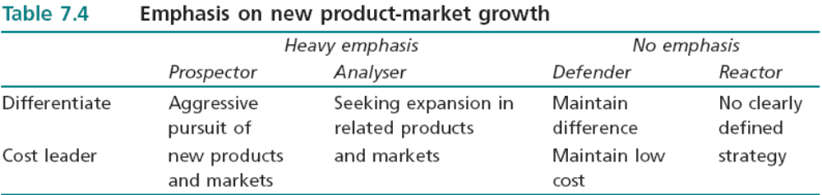
Generic Strategies
The approach to strategy is partly dependent on the overall or dominant characteristic of the decision maker or decision making group
Prospector: identification of new market opportunities
Analyser: sophisticated internal information systems and detailed investigation of options, but this is unlikely to be followed up by the type of action undertaken by the Prospector
Defender: maintaining the current market position without exhibiting a great deal of initiative in developing new market opportunities
Reactor: deals with circumstances as they arise.
These dominant characteristics may be relevant only to a specific period, and will obviously change as managers are replaced.
Help towards understanding how the company has reached the position it is in, and the type of strategy which might win general support.
EBS MBA / AUC

Slide 50
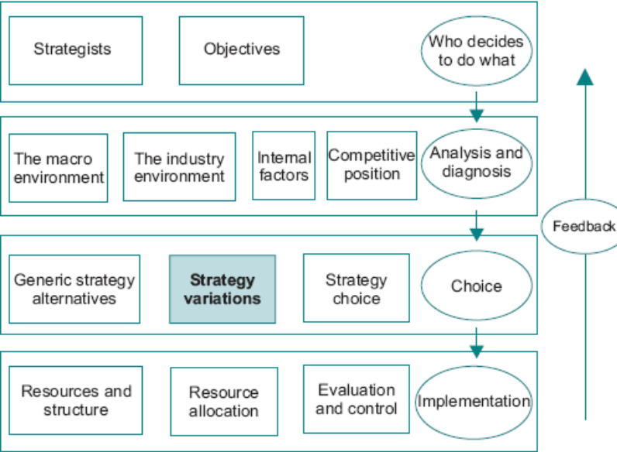
Identifying Strategic Variations
The next step is to identify which courses of action are available in order to achieve the identified objectives.
Within the context of a given generic strategy some broad classifications can serve to reduce the options which have to be evaluated.
Related and Unrelated Options 7/17
Vertical Integration 7/19
Acquisitions 7/19
Alliances and Joint Ventures 7/23
International Expansion 7/23
From Generics to Options

Slide 51
Identifying Strategic Variations
Related and Unrelated Options - relatedness
Vertical Integration – backward / forward
Acquisitions – reasons:
  Recognising Unrealised Value
  Buying Market Share
  Reducing Competitive Pressures
  Synergy
  Balancing the Portfolio
  Core Competencies – fit with direction
Alliances and Joint Ventures - Arms-length contracts taking many forms, including licensing agreements, franchise agreements, relational contracting, relational management, consortia, virtual corporations, virtual functions and joint ventures. It’s Rational vs. merger is key.
International Expansion - focus on the elements of competitive advantage which can be transferred. Challenges include:
  Volatile exchange rates present serious problems – hedging
  Relative factor costs and productivity vary by country.
  Governments often protect home production.
  Cultural norms
  economies of different countries
EBS MBA / AUC

Slide 52
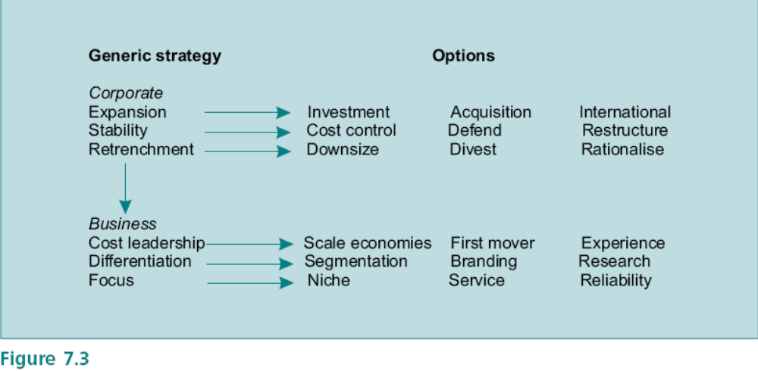
Identifying Strategic Variations
6. From Generics to Options
At the corporate level the generic strategy chosen requires the implementation of an option.
But at the same time these corporate choices must be underpinned by business level generic strategies.
The important issue is to recognise the need to align the different levels of strategy with appropriate options.
not mutually exclusive
logic of the choice process.
EBS MBA / AUC

Slide 53
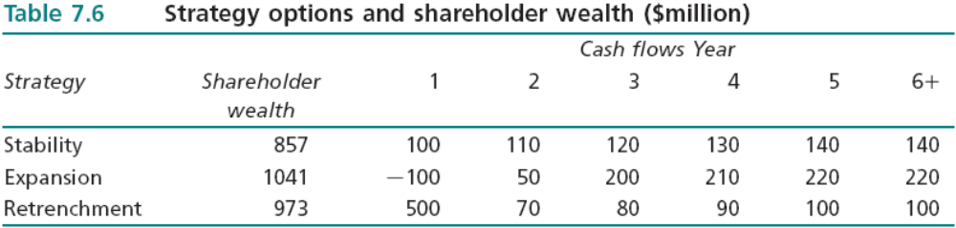
Strategy Choice
Shareholder Wealth
  Shareholder Wealth - the present value of the future cash flows expected to be generated by the company.
  Strategy Choice problem - identification and selection of the strategy option which maximises shareholder wealth.
  Many factors intervene which make the connection between proposed courses of action and the impact on shareholder wealth difficult to identify. Hence Shareholder wealth model can only be taken only as a starting point.
  potential cash flows derived from analyses of markets, competition, opportunities, threats, environmental factors and so on.
  A further powerful application of shareholder wealth analysis is to break down the activities of the company (or SBUs) and estimate the contribution which each makes to the total value of the company.
EBS MBA / AUC

Slide 54
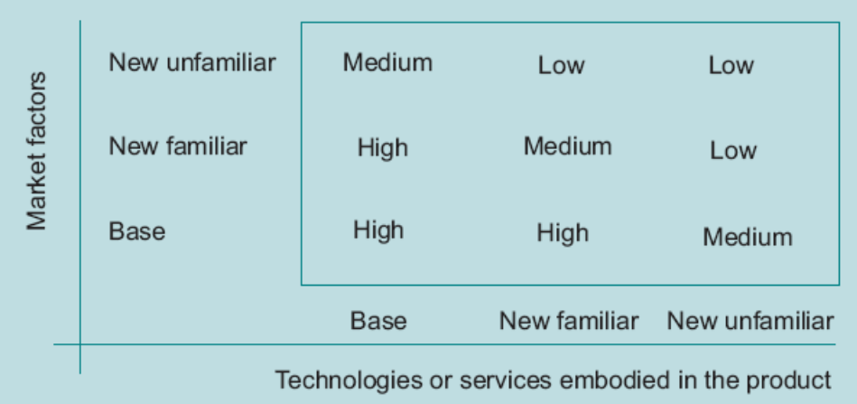
Strategy Choice
Performance Gaps
  In SH example, the shareholder wealth analysis may advise several strategies which would accomplish the expansion option. The identification of the desired future state greatly narrows the range of feasible strategic options.
  the gap approach reduces the array of strategy alternatives to those which have direct relevance to the company’s objectives and to its potential capacity.
Corporate Management
  Portfolio of products – ex. BCG Matrix. Complicating factor is to make a strategic response to other companies which are developing their portfolios.
  Portfolio approach is a powerful tool in identifying areas which the company should be putting its resources. The weakness lies in identifying which products to put.
  The aim is thus to achieve a balanced but linked portfolio. One method of assessing the risks involved is the ‘Familiarity’ Matrix.
Figure 7.4 Familiarity matrix

Slide 55
Strategy Choice
SBU Management
  Focus on exploitation of products and markets, and with ensuring that resources are allocated efficiently.
  Using project analyses, sensitivities and scenarios.
Risk and Uncertainty Analysis
  managers are faced with the problem of making tradeoffs between the prospect of varying returns and possibilities of failure. possible outcomes and probabilities.
  attitude of managers to risk - risk aversion,
  Uncertainty – unforeseen events, allowance to account for it.
  essential that strategies are constructed which have the potential to adapt to circumstances.
  contingency planning, which involves making sure that the strategy is capable of responding to a wide variety of scenarios, and keeping options open as long as possible.
Managerial Perceptions - factors which bear on decision makers which might help to explain observed behaviour:
  External Dependence
  Attitudes to Risk
  Previous Strategies
  Managerial Power Relationships
  Consensus Decisions: The Paradox of Voting

Slide 56
Strategy Choice
Managerial Perceptions - factors which bear on decision makers which might help to explain observed behavior:
  External Dependence – on customers, suppliers, majority shareholders.
  Attitudes to Risk – minimax criteria (lowest potential loss)
  Previous Strategies - success of the previous strategy may contain the seeds of future disaster
  Managerial Power Relationships – internal politics, principle agent problem,
  Consensus Decisions: The Paradox of Voting - voting is as subject to manipulation as any other decision technique, although it is less obvious to the participants.

Slide 57
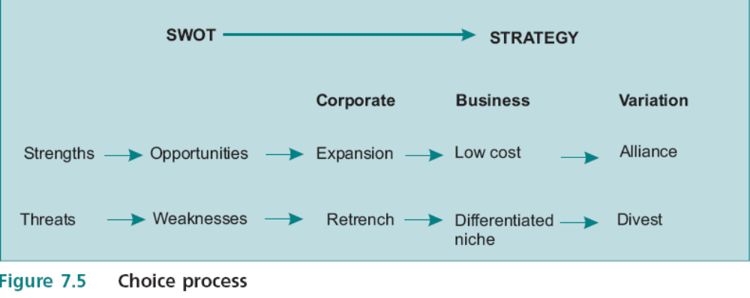
Strategy Choice
From SWOT to Generics
identified the appropriate entries for each box in the SWOT matrix
align strengths with opportunities and weaknesses with threats
Insights into the most appropriate corporate strategy, best business generic can be identified together with the strategy variation.
What happens if both of these are identified within the same SWOT analysis? That is when the CEO has some tough choices to make and really starts to earn her money.
EBS MBA / AUC

Slide 58
Strategic Planning
Module 8
Implementing and Evaluating
Strategy

Slide 59
Contents
Implementing Plans
Organizational Structure
Resource Allocation
  Management of Change (reallocation of resources, resistance)
  Critical Success Factors (must be done)
  Management Style (leadership style, culture)
  Budgets (problem of allocating budgets – both Corporate and SBU levels, capital rationing)
  Incentives and Alignment (must be aligned with objectives)
  Setting Sales Targets
  Resource Planning (communication / linkages)
Evaluation and Control 8/12
  Monitoring Market Share 8/14
  Monitoring Profitability 8/15
Feedback 8/18
The Augmented Process Model 8/19
Postscript: Strategic Planning Works 8/23
EBS MBA / AUC

Slide 60
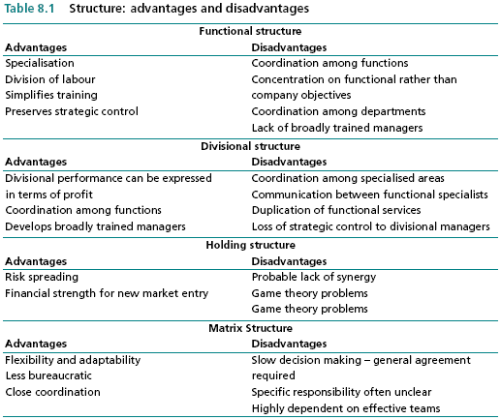
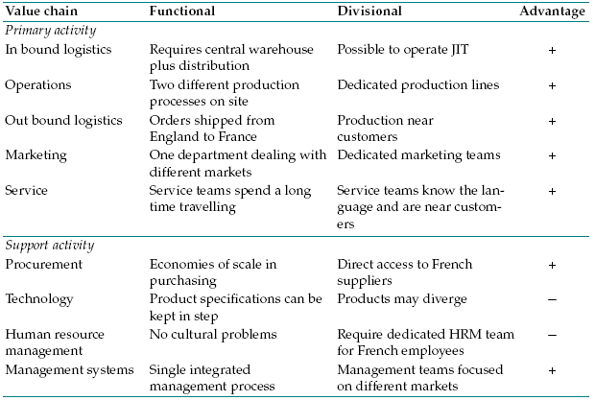
Organizational Structure
2 key questions to ask:
How different forms of organization are likely to contribute to the creation of value?
Is the structure likely to be consistent with, or flexible enough to deal with, predicted changes?

Slide 61
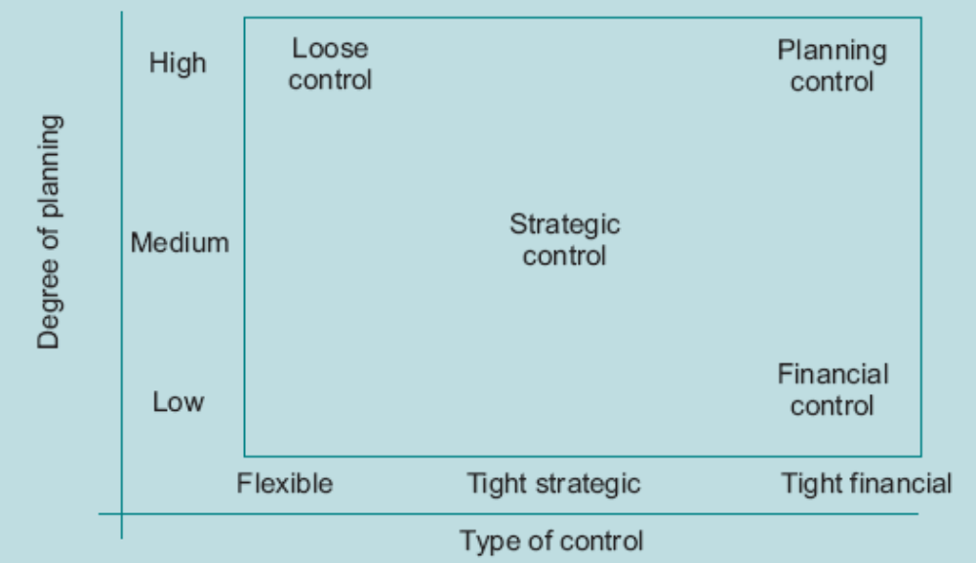
Evaluation and Control
The steps in evaluation and control are:
1 - Decide what is to be measured.
2 - Decide how it is to be measured.
3 - Interpret the outcomes.
4 - Convert into policies.
Some companies rely largely on financial indicators, while others take into account a wider range of measures which reflect competitive positioning – ex balanced score card.
Uses a variety of control methods and gives a balanced weighting to planning and control influences.

Slide 62
Feedback
Therefore it is not sufficient to scan the environment and monitor company performance; it is necessary to be able to act on information and changes as they occur.
There are at least three dimensions to effective feedback.
Company Adaptability
  attitude to change.
  willingness of individuals to listen to information which may often not be to their liking,
  Be prepared to admit mistakes, and be proactive.
Company Communications
  How is information disseminated both upwards and downwards
  Company structure is key in this
Company Learning
  Ability of organization to learn from and build on past experience
  Reinvent the wheel each time!
  organization as a whole capitalizes on the learning of the individualism is key.

